Slide 1


Data Governance @ SneakerPark
Prepared by: Joseph Corrado
Submitted on: 1/9/2022

Slide 2
Background
SneakerPark is an online shoe reseller that allows people to buy and sell used and new shoes. Buyers can bid for shoes or buy them outright, and sellers can set a price or sell to the highest bidder.
Each buyer and seller must have an active account in order to sell, bid, or purchase sneakers using SneakerPark’s website.
SneakerPark authenticates the shoes before shipping them to the buyer, so before listing an item, the seller must ship it to SneakerPark’s warehouse. Upon receipt, SneakerPark assigns an item number to each pair of sneakers and notifies the seller that they are now free to list their item. If the item is not listed within 45 days, SneakerPark returns it to the seller and sends an invoice to the seller for the shipping cost.
If the item is found to be inauthentic or in an unacceptable condition, it is also returned back to the seller in a similar fashion.
When the item sells, the buyer’s account is credited with the purchase price minus the SneakerPark service fee and shipping fees to deliver the item to the buyer.
Currently, SneakerPark only supports sales within the United States.

Slide 3
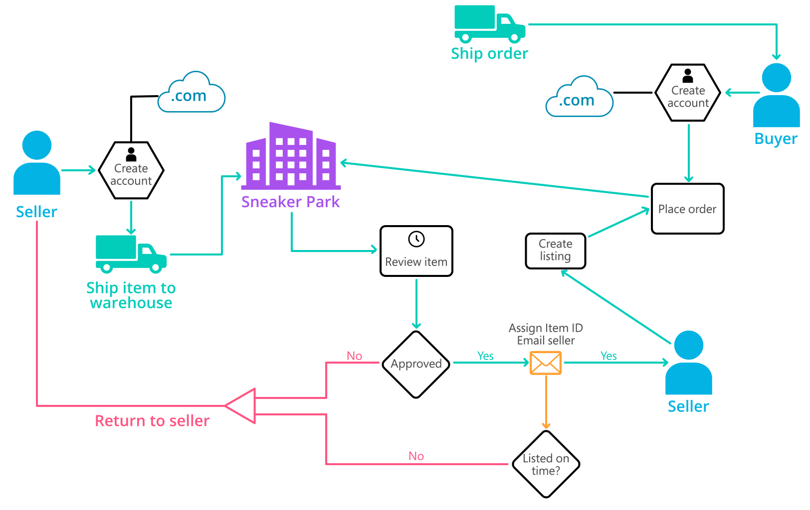
Background (cont’d)
Below you can see a diagram that will hopefully help you visualize some of SneakerPark's business processes. Keep in mind that it does not capture ALL processes and every nuance, but simply serves as another artifact to use in your project.

Slide 4
Step 1
Enterprise Data Catalog Part 1: Enterprise Data Model

Slide 5
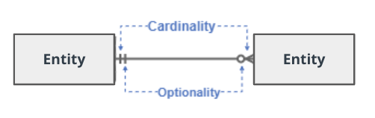
Create a conceptual data model that will provide SneakerPark with a holistic view of its data systems and help you grasp the organization's important entities and relationships, which will be instrumental as you move further in the project. You can use Lucidchart or any other diagramming tool of your choice, but please use the Crow’s Foot/IE Notation and please be sure to indicate both cardinality (the type of a relationship such as 1:N or N:N) and optionality (whether the relationship is optional or mandatory).

Slide 6
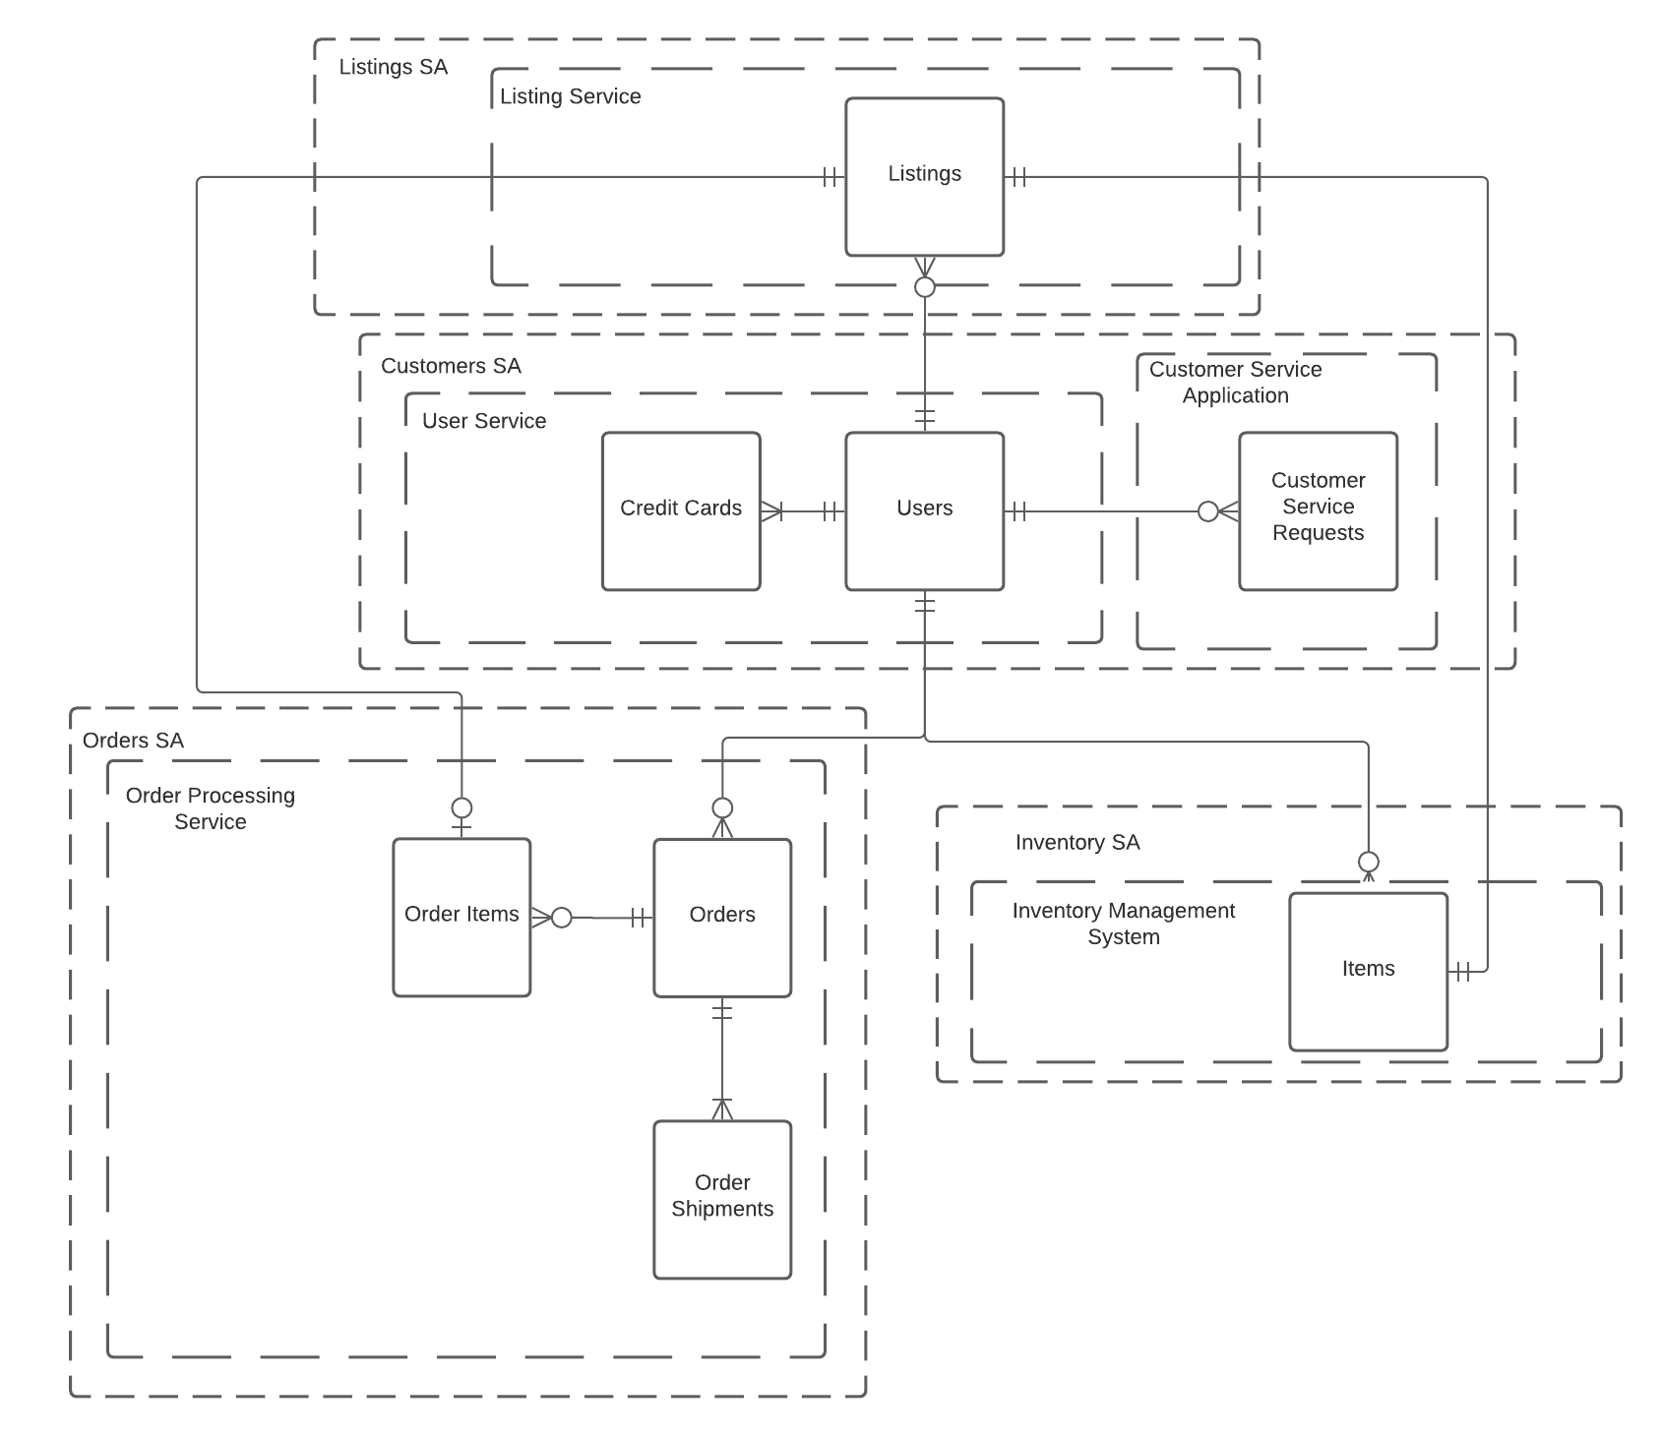

Slide 7
Step 2
Enterprise Data Catalog Part 2: Metadata

Slide 8
Create the first version of the Metadata Catalog by documenting the metadata from all systems in the "Data Dictionary" and the “Enterprise Data Catalog” tabs of the provided Sheets template.
Please note that you are required to fill out all fields in both tabs.

Slide 9
Step 3
Data Quality
Part 1: Profiling and Cleansing

Slide 10
Profile the data to identify at least 3 data quality issues you see in the data. Also provide at least 1 data quality issue that you haven’t yet seen in the data, but can foresee occurring in the future. Based on the issues you’ve identified, come up with the data quality rule for each data quality issue, including for the one that you foresee.
Make sure you fill out all columns in the "Data Quality Issues" tab with your answers in the provided Sheets template.

Slide 11
Step 4
Data Quality
Part 2: Monitoring

Slide 12
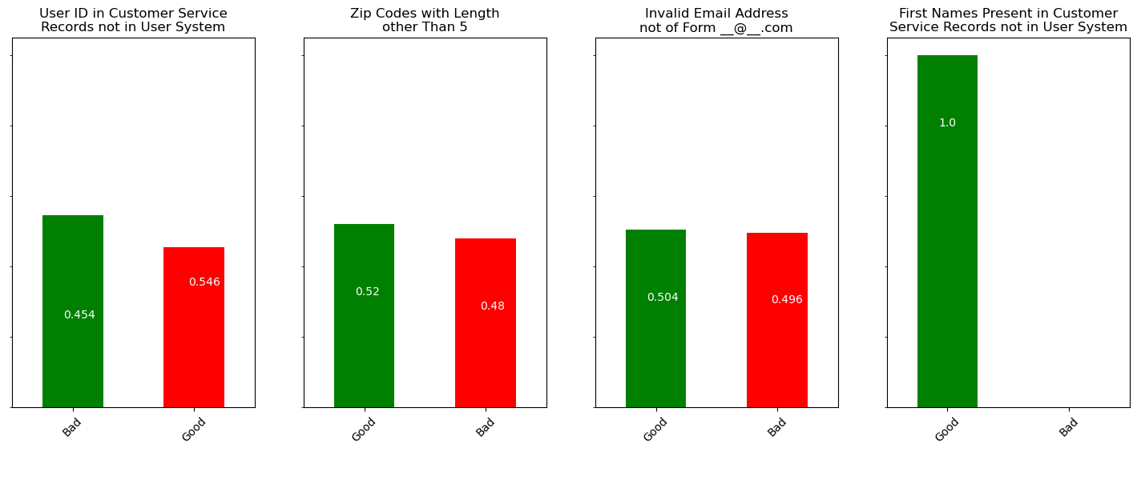
Using the metrics you've created in the last step, please create a mock-up of a data quality monitoring dashboard that will be used to monitor the data to ensure compliance with your data quality rules.
Please make sure to label your metrics clearly on your mock-up.

Slide 13
Step 5
Master Data Management
Part 1: MDM Architecture

Slide 14
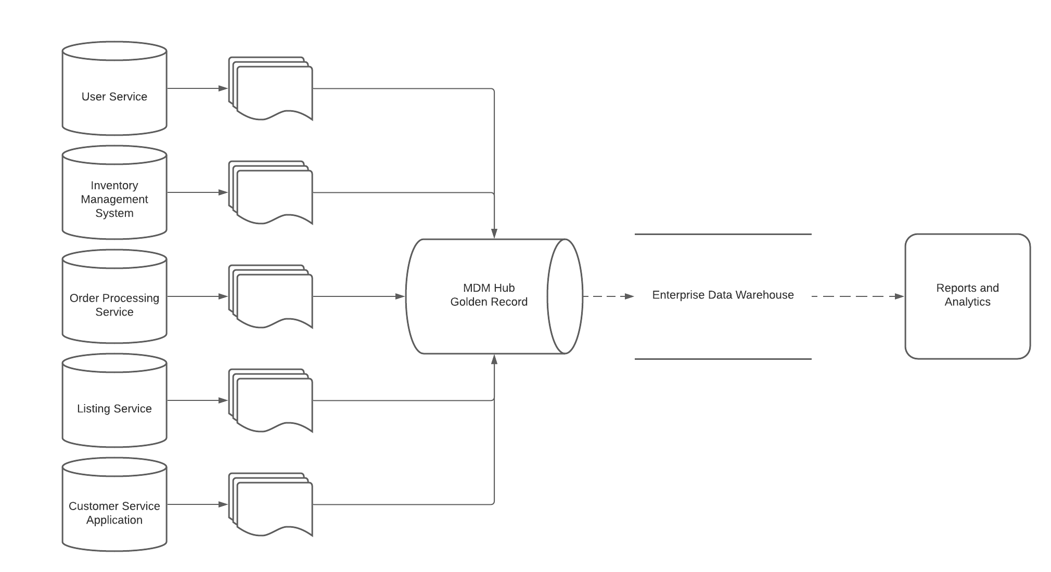
Based on what you’ve read about SneakerPark’s systems and business model, sketch out a proposed MDM implementation architecture, and write a detailed explanation of why you chose this specific approach.

Slide 15
The goal of this data governance initiative is twofold:
to increase visibility and control over the systems
to prepare for a data warehouse phase 2 initiative
Because of these goals, it would be most appropriate to choose a consolidation/analytical style master data management system.
The registry option is too simple, and doesn't lay the foundation for creating an enterprise data warehouse in phase 2. In addition, all the registry style option does it store references to your source systems, so it doesn't actually help you gain any control or visibility into your data - you're simply noting where specific data can be found.
In addition, the consolidation method doesn't require a complicated engineering effort, and it's not very intrusive. It doesn't place a burden on the source systems, and it can be implemented with a relatively straightforward batch job that runs on a schedule.
The consolidation method also lends itself nicely to later creating an enterprise data warehouse, as you'll already have all the data in a golden record location.
The centralized implementation would be very intrusive to the existing source systems. Not only that, but it would be expensive, and a rather difficult manuever for the company's first data governance initiative.
Finally, the coexistence method is just inappropriate for the company's first attempt at a data governance solution. You'd need an expensive team having a large amount of knowledge about creating and maintaining a bidirectionally syncing system.

Slide 16
Step 6
Master Data Management
Part 2: Master Record

Slide 17
In this step, you will define a set of matching rules that will be used by the SneakerPark's MDM Hub to match item and customer entities between the company's different systems.
A given customer in the users system is the same as one in the order processing system if they have the same email.
A given customer in the users system is the same as one in the service requests system is the same if they have the same first name, last name and email address.
A given item in the listings system is the same as an item in the order management system if that item has the same product ID
A given item in the listings system is the same as an item in the inventory management system if they have the same product ID

Slide 18
Step 7
Data Governance:
Roles and Responsibilities

Slide 19
Write 1-2 paragraphs discussing what data governance roles and responsibilities will be necessary to oversee this new Data Management initiative. Please be sure to discuss the responsibilities in the context of at least 3 different aspects of Data Governance (such as Data Quality Management, Metadata Management, MDM, etc). Based on what you know, do SneakerPark's current employees have the necessary skills for these roles or should the company make new hires?
To oversee this data management initiatives, we require domain experts, data stewards, database administrators and IT personnel.
Based on what I know of SneakerPark's team, I believe they could get away with not making new hires, but they should at the very least hire consultants to build out their data governance and data visibility systems.
However, I would feel most comfortable with recommending that they hire people dedicated to the data governance and visibility efforts. This is necessary because the company already has several production systems, and we have forward-looking goals for the management and administration of those systems and data. It would be best to have dedicated personnel that can communicate with the domain experts, existing IT, and then work to document and create systems that will continuously monitor those systems and data.
For data quality management, we'll have people who are familiar with the underlying tables and data in the systems, but may not be domain experts - these will be our IT personnel/engineers. In addition, we'll have domain experts who will know how to interpret that data, or any consequences/interpretations of that data in light of the business and its goals - these will be our domain experts.

Slide 20
The domain experts will need to be notified, and keep on top of the overall quality of data, and watch for anything that needs intervention, but the IT personnel/engineers will be responsible for enabling those domain experts access to the data, answering questions and creating systems that make any aspects of the data obvious and brought to the forefront of their attention.
For metadata management, we'll require some administrators or consultants that can set up such a centralized system, communicate with the IT personnel of each of the systems that exist, and can cultivate and maintain the metadata from those various systems.
The metadata management personnel needs interpersonal skills, and the motivation to go around to the domain experts and the IT personnel of the company, hold multiple meetings repeatedly, and collate all of their learnings, in a well organized, elegant solution. If these metadata management administrators don't do a good job here, no one will use it, and it will wind up providing no value.
For master data management, we'll leverage our metadata management systems, and any existing IT/engineers to create the data pipelines and ETL that will move the data from the source systems into our consolidated system.
This aspect of data governance is expensive, and requires a lot of resources to be assigned to it. You require engineers to build the data pipelines and write ETL, and you require people to validate and automatically test the data that is extracted.
In addition, you require metadata management systems so the engineers can learn how they should build their ETL systems to coalesce repeated data from different systems into a golden record.

